Slide 1

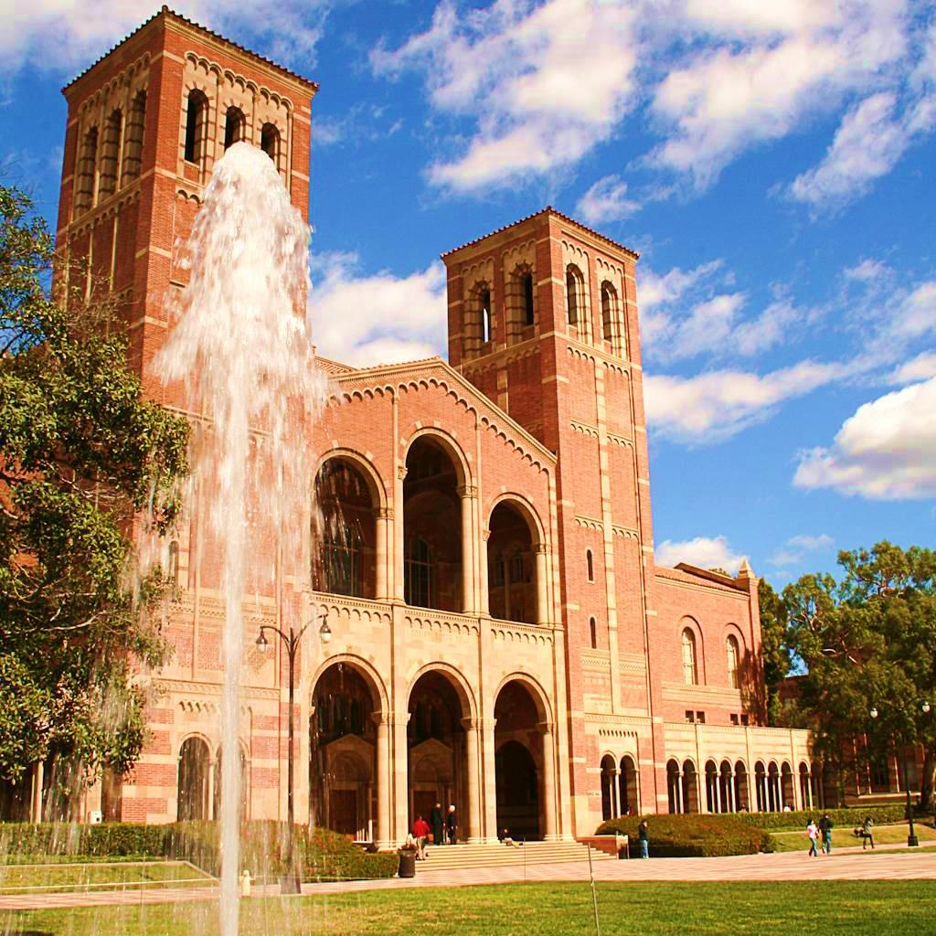

College and Career
Readiness
Middle School
UCLA

Slide 2
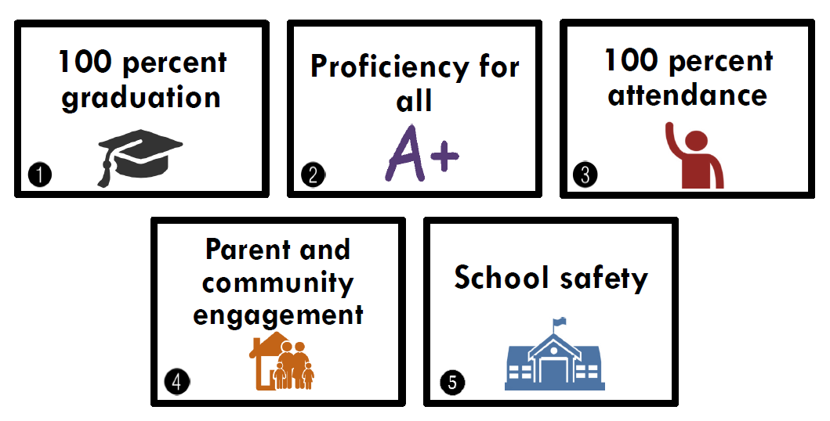
DISTRICT GOALS

Slide 3
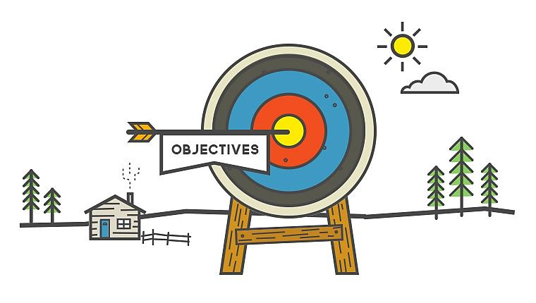
OBJECTIVES
  Understand the benefits of being college and career ready
  Increase your knowledge of the A-G subject requirements
  Learn about the requirements for the Middle School Certificate of Completion and Culmination Activity
  Use the College and Career Readiness Monitoring Tool to track your academic progress
  Increase your awareness of honors and advanced placement (AP) courses
  Understand the importance of a competitive grade point average (GPA)
  Gain knowledge about the Noncognitive Skills

Slide 4


SUCCESSFUL
CAREER
ROAD MAP
COLLEGE
High School
Middle School
Preschool to College and a Career
Elementary School
PRESCHOOL

Slide 5



College and Career Readiness
How do we become college and career ready?

Slide 6

How do I prepare?

Slide 7







You must…
Earn good grades
Score high on tests
Complete classwork and homework
Attend school daily and on time
Participate in class
Work hard

Slide 8



Let’s Review…
Describe three actions you can take to be college and career ready.
T • P • S

Slide 9




Interesting Facts
The majors with the best pay include Engineering, Economics and Physics.
SOURCE: “THE BEST AND WORST COLLEGE DEGREES BY SALARY” CBS MONEY WATCH.COM

Slide 10

The Benefits

Slide 11




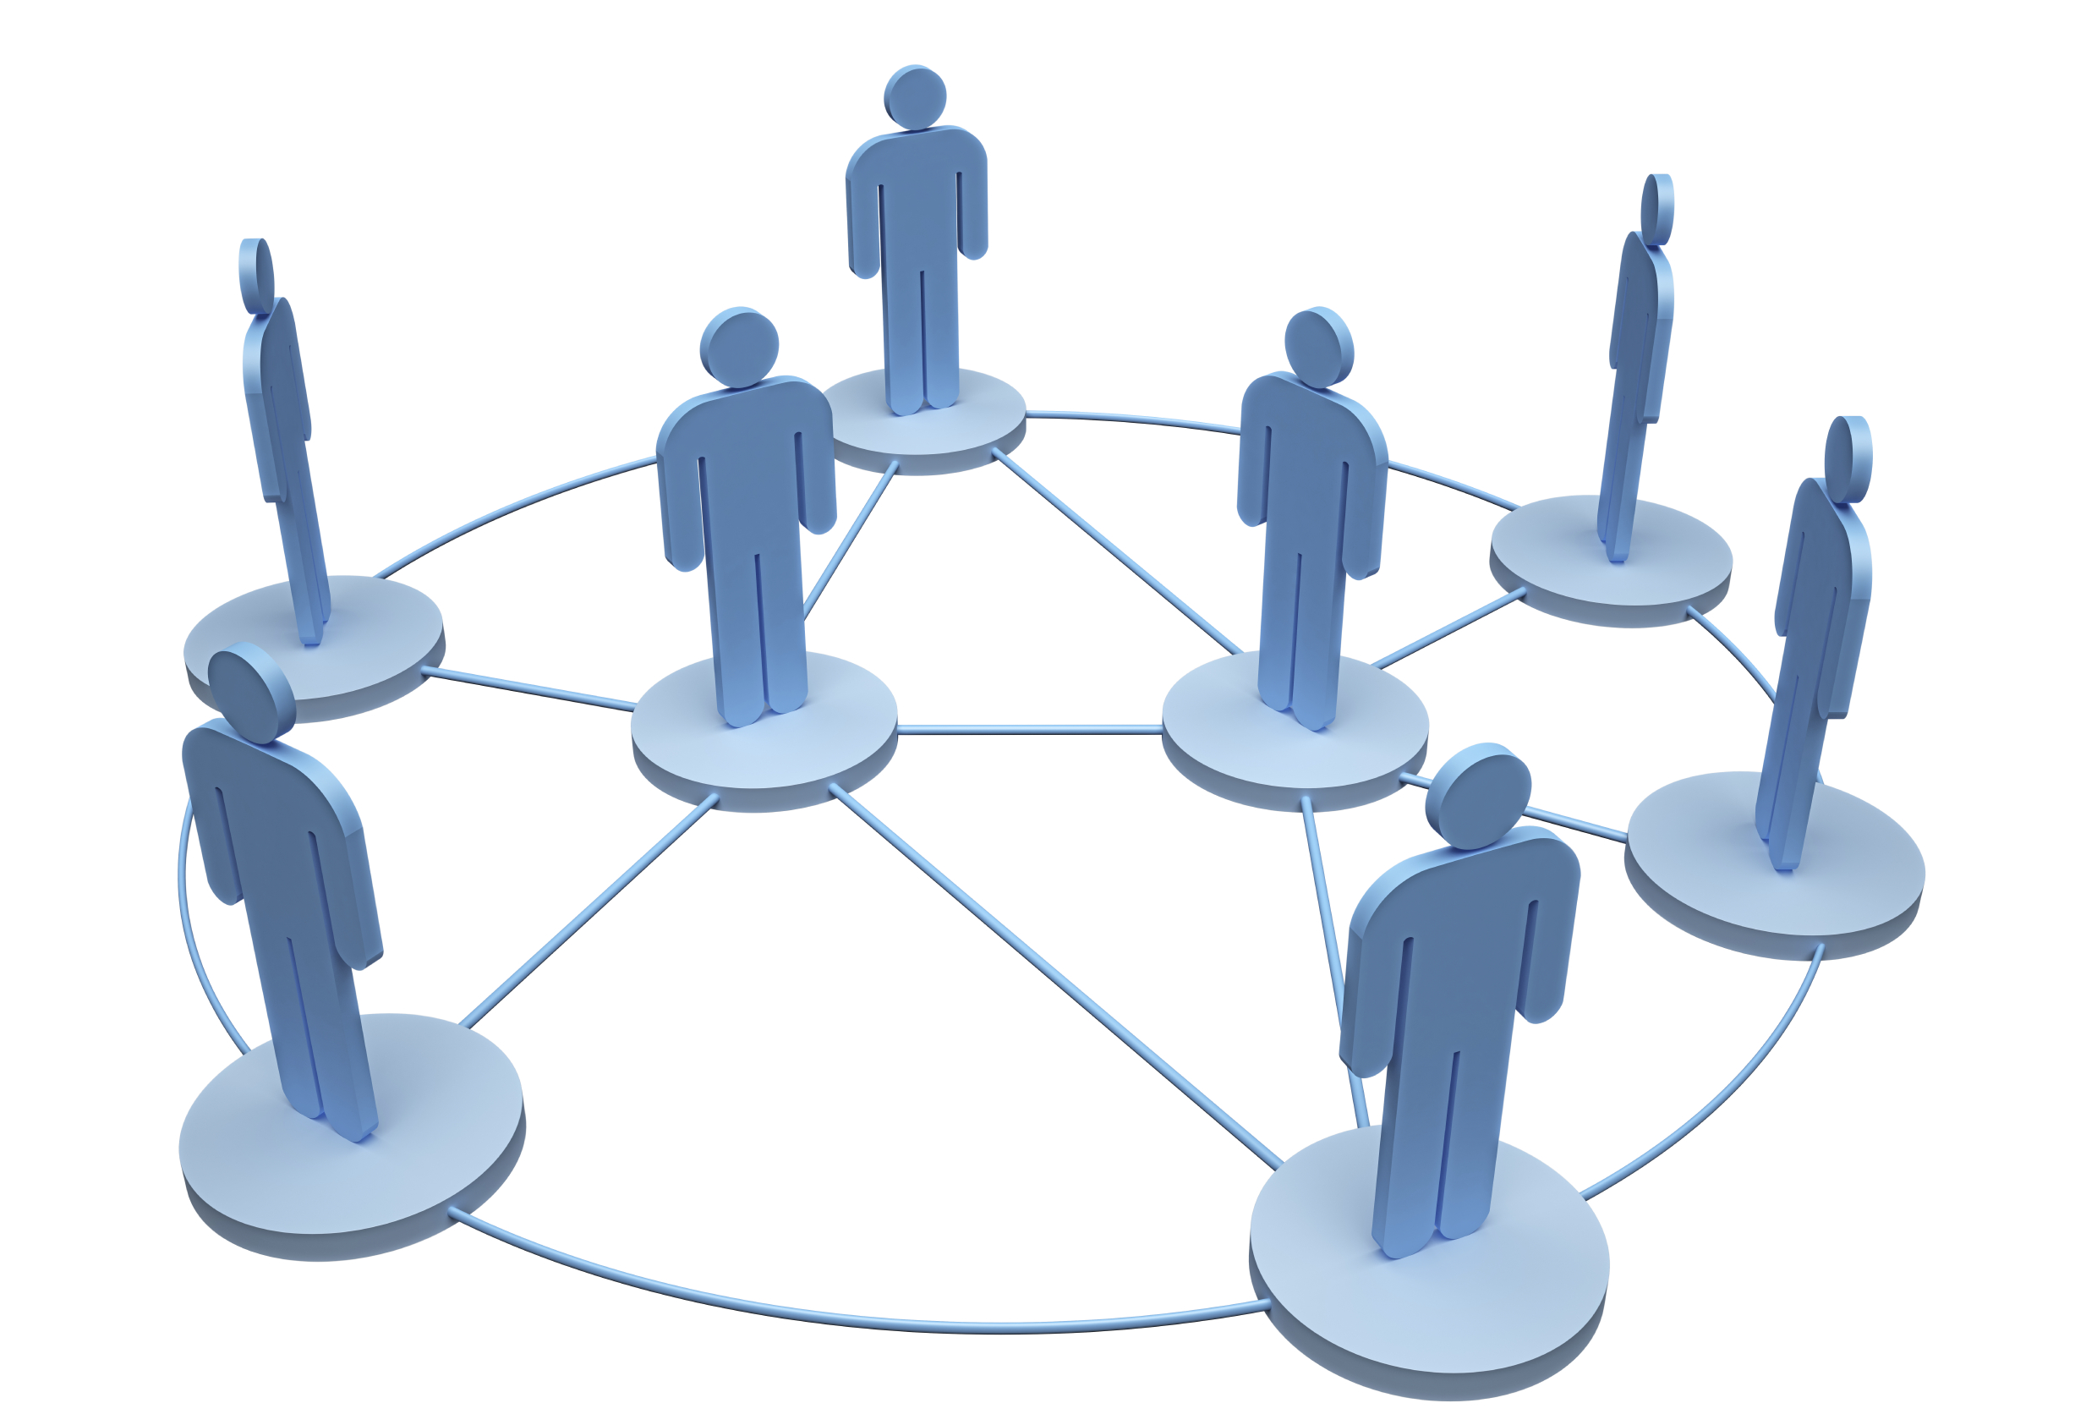
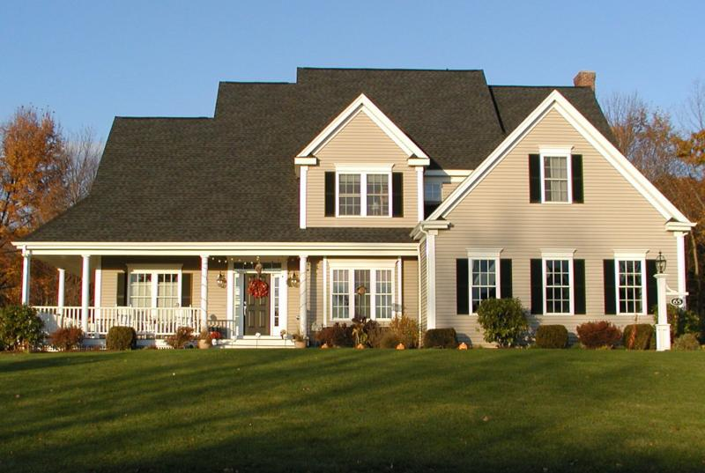

BENEFITS
Acquire Knowledge
Be Career Ready
Increase Future Earnings
Increase Network
Secure a Better Future
Widen Horizons

Slide 12

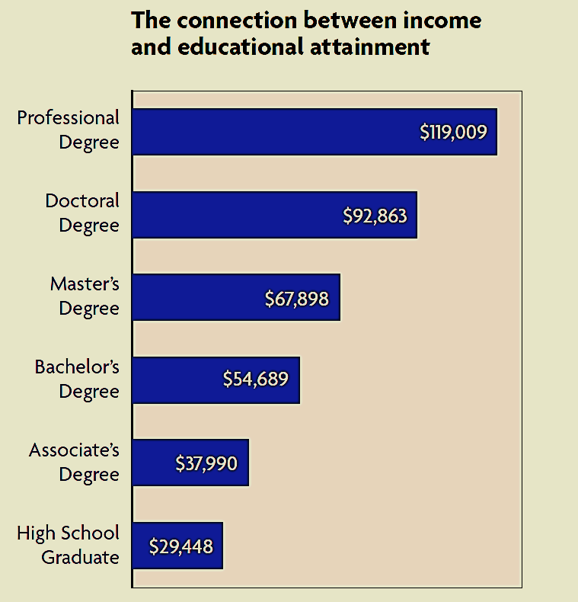

Why graduate college and career ready?
Income and Educational Attainment
Doctor, Dentist
Hospital Administrator
Advance-Practice Nurse
Physician Assistant
Dental Hygienist
Medical Assistant
No High School Diploma
$23,940
SOURCE: EDUCATION PAYS - THE BENEFITS OF HIGHER EDUCATION FOR INDIVIDUALS AND SOCIETY

Slide 13

Let’s Review…
Name three benefits of becoming college and career ready.
T • P • S

Slide 14



Interesting Facts
College graduates have a longer life span. The risk of dying prematurely is on the increase for Americans with less than a high school education, while the risk of premature death among college graduates is falling.
SOURCE: COLLEGE DEGREES.COM

Slide 15
What are the A-G requirements?

Slide 16
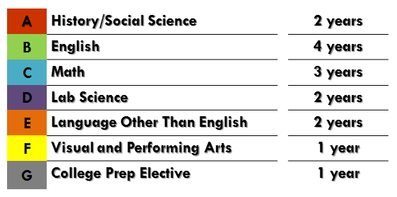
A-G
Minimum Requirements
  THE A-G COURSES WILL…
  prepare you to do well in college
  help you improve your critical thinking skills
  expose you to diverse academic subjects
A sequence of high school courses that must be met in order to be admitted to a University in the UC (University of California) or CSU (California State University) system.

Slide 17
A-G Minimum Requirements
A | History/Social Science |  | 2 years
B | English |  | 4 years
C | Math |  | 3 years
D | Lab Science |  | 2 years
E | Language Other Than English |  | 2 years
F | Visual and Performing Arts |  | 1 year
G | College Prep Elective |  | 1 year
3 - 4 years
4 years
3 - 4 years
3 - 4 years
2 years
In order to be a competitive candidate, you must take courses beyond the minimum requirements.

Slide 18



A-G
CDE
LAUSD
HIGH SCHOOL GRADUATION
REQUIREMENTS

Slide 19
Physical Education |  | 2 years
*History/Social Science |  | 1 year
A – History/Social Science |  | 2 years
B – English |  | 4 years
C – Math |  | 3 years
D – Lab Science |  | 2 years
E – Language other than English (LOTE) |  | 2 years
F – Visual and Performing Arts |  | 1 year
G – College Preparatory Elective |  | 1 year
Health |  | ½ year
Service Learning |  | Non-Course Requirement
Career Pathway Selection |  | Non-Course Requirement
CDE
A-G
The A-G Requirements
align with the
HIGH SCHOOL GRADUATION Requirements
LAUSD
* The California Department of Education requires an additional year of History/Social Science (Principles of American Democracy and Economics).
Notes:
Service Learning - Usually incorporated into a history course
Career Pathway Selection - Conversation with high school counselor

Slide 20
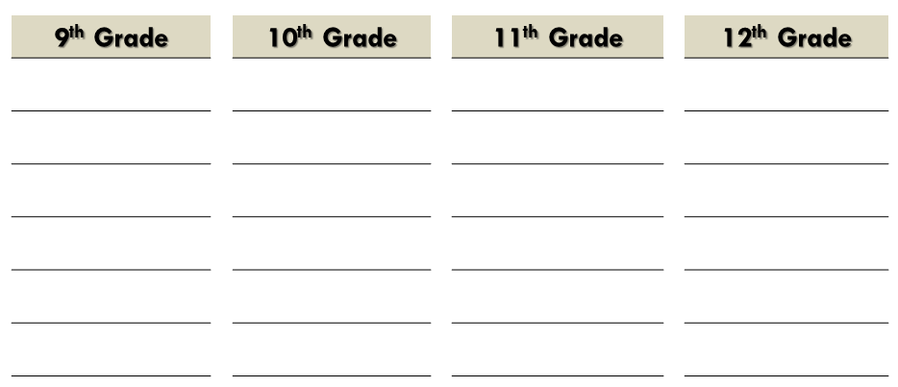

HIGH SCHOOL SCHEDULE
9th Grade |  | 10th Grade |  | 11th Grade |  | 12th Grade
Physical Education |  | Physical Education |  | F Visual/ Performing Arts |  | Health | D
History/Social Science |  | A History/Social Science |  | A History/Social Science |  | D College Prep Elective
B English |  | B English |  | B English |  | B English
C Mathematics |  | C Mathematics |  | C Mathematics |  | C Mathematics
D Lab Sciences |  | D Lab Sciences |  | D Lab Sciences |  | D Lab Sciences
E Language Other Than English |  | E Language Other Than English |  | E Language Other Than English |  | E Language Other Than English
Service Learning
Career Pathway Selection

Slide 21
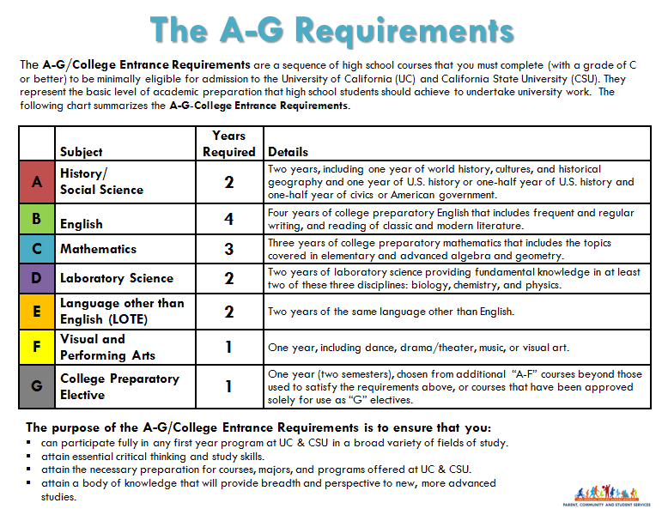

More information about the A-G requirements

Slide 22

Let’s Review…
What are the A-G requirements?
Which academic subject falls under requirement “A”?
How many years of English are required?
How many years of mathematics are required?
What does LOTE stand for?

Slide 23
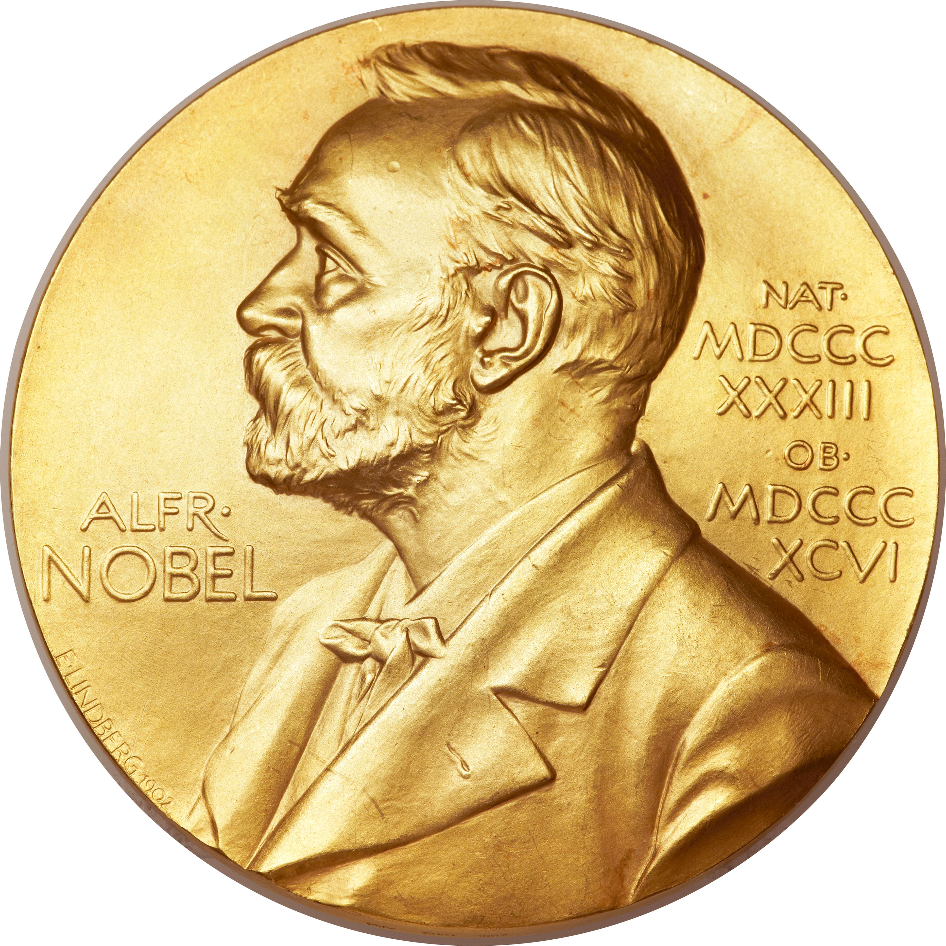
Interesting Facts
California has 3 of the top 10 universities in the United States that produce the most Nobel prizewinners – Stanford University, University of California, Berkeley and University of California, Santa Barbara.
SOURCE: Education Pays: TOP 10 UNIVERSITIES FOR PRODUCING NOBEL PRIZEWINNERS - WWW.TIMESHIGHEREDUCATION.COM

Slide 24
Monitoring Tools

Slide 25

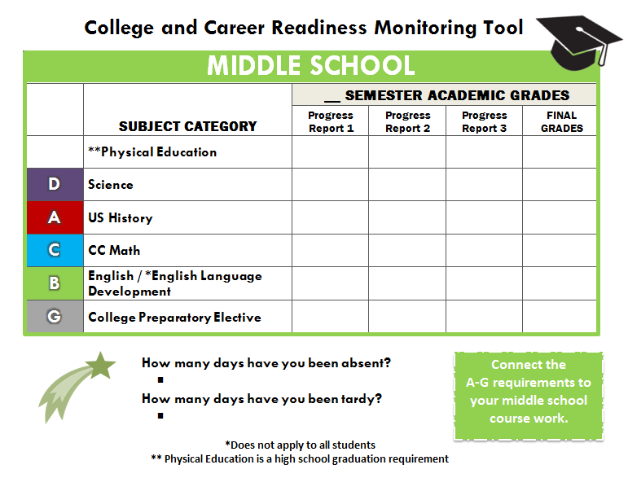
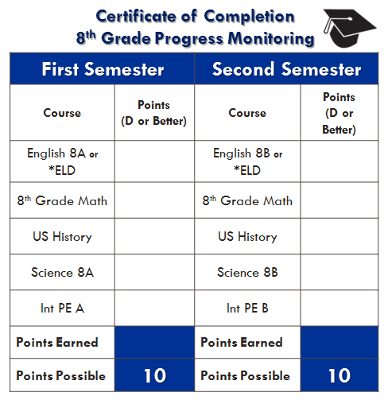
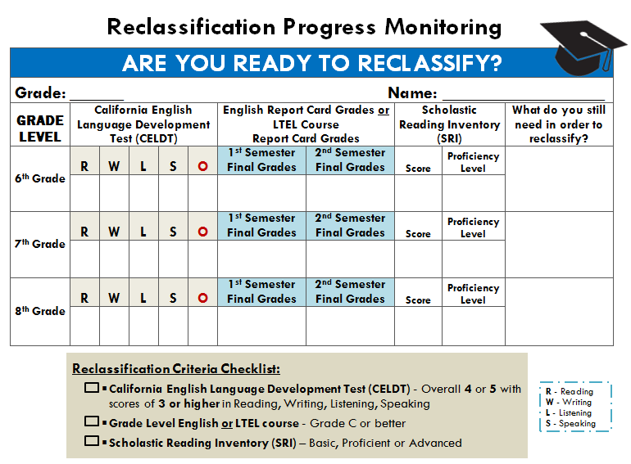
Monitoring Tools
Use them to track your College and Career Readiness Progress!

Slide 26

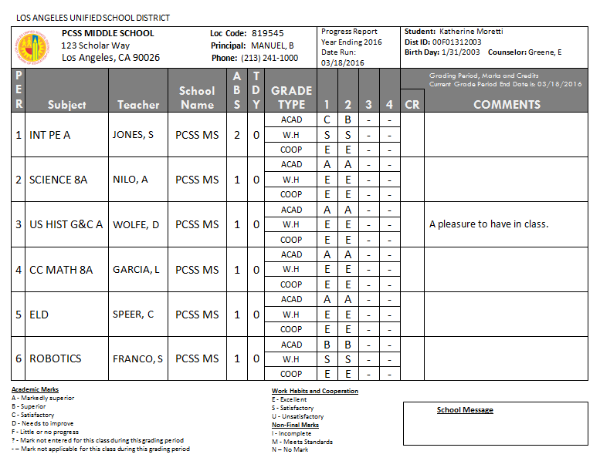
Monitor Your Progress

Slide 27
Monitor Your Progress
A
Input your grades for each academic area in the corresponding boxes.

Slide 28
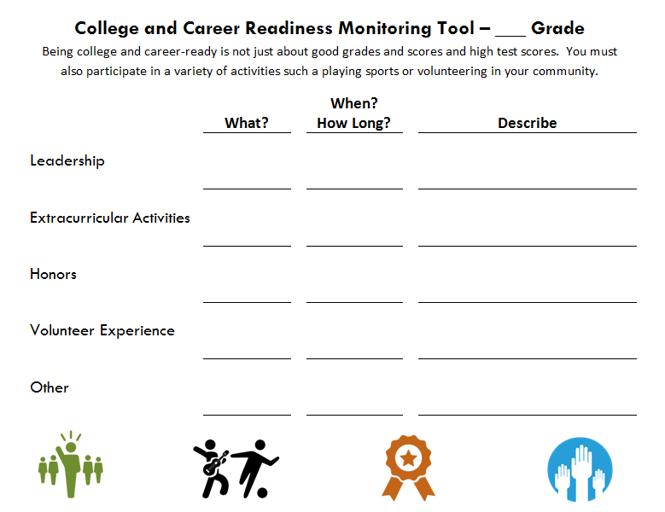
Monitor Your Progress
Associated Student Body Secretary
Planned meeting agenda, took meeting minutes and attendance, ran meetings in absence of president/ vice-president.
2 years

Slide 29
Monitor Your Progress
Input your grades/scores in the corresponding boxes for each requirement.
3

Slide 30


Improve your grades!
T • P • S
  Are you earning the highest marks you can earn?
  Are you on track to earn a Certificate of Completion?
  Which areas do you need to improve?
  What can you do to improve?
A
D

Slide 31

Interesting Facts
You can get a “Pirate Certificate” at the Massachusetts Institute of Technology (MIT). You must complete courses such as archery, sailing and fencing.
SOURCE: MIT AWARDS PIRATE CERTIFICATES TO UNDERGRADUATES – BOSTONGLOBE.COM

Slide 32
Grade Point Average

Slide 33



High School Marks
Academic Marks
Grade | Meaning
A | Markedly Superior
B | Superior
C | Satisfactory
D | Needs to Improve
F | Little or no Progress
Work Habits and Cooperation Marks
Grade | Meaning
E | Excellent
S | Satisfactory
U | Unsatisfactory

Slide 34

Grade Point Average (GPA)
The importance of a competitive GPA
A high GPA indicates hard work, dedication and commitment to your academic success – all qualities that matter to colleges and universities!
GPA is one of the major items that universities look at when reviewing applications for admissions.

Slide 35
Grade Point Average (GPA)
The importance of a competitive GPA
Colleges also look for an upward trend in GPA. They want to see your grades get better over time.
Having a slightly lower grade in a very challenging course such as Honors or AP U.S. History, looks better on your record than a high grade in a regular, less challenging course.

Slide 36
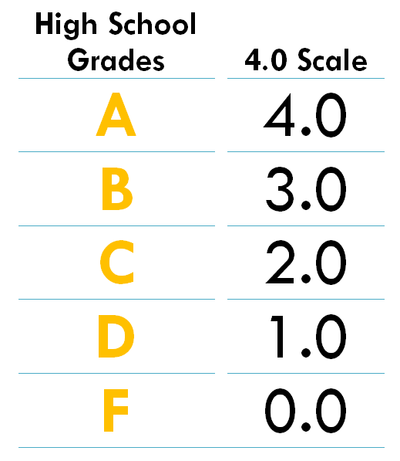


GPA
Grade Point Average
The higher your grades, the more points you will earn!
Kathy
Eddie
SOURCE: ADAPTED FROM THE COLLEGE BOARD WEBSITE

Slide 37
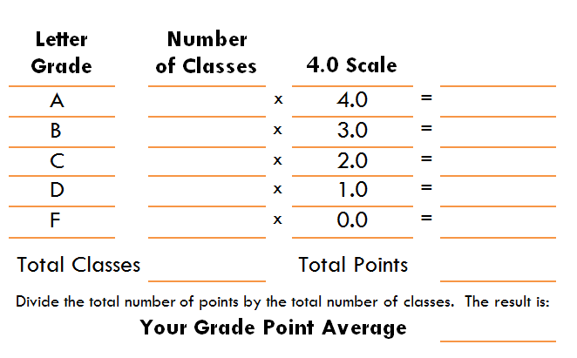
GPA
Grade Point Average
3
12
2
6
3
6
4
4
12
28
Eddie
2.3
Adaptado del Sitio de Internet The College Board

Slide 38
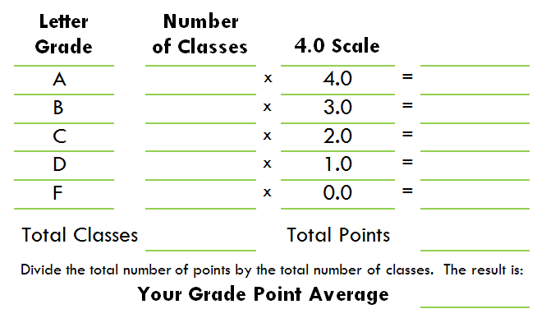
GPA
Grade Point Average
11
44
1
3
12
47.0
v
Kathy
3.9
Adaptado del Sitio de Internet The College Board

Slide 39


GPA - Grade Point Average
Who is better prepared to go to college Eddie or Kathy? Why?
What can Eddie do to improve his GPA?
Why is it important to have a high GPA?
Kathy
Eddie

Slide 40


Grade Point Average (GPA)
Your grades matter!
3.8 to 4.0+
GPA
Below 2.0
GPA

Slide 41
Monitor Your Progress
A

Slide 42


Let’s review…
What is your GPA?
What specific actions can you take to improve your GPA?
T • P • S

Slide 43


Interesting Facts
The first intercollegiate football game took place on November 6, 1869. Teams from Princeton University and Rutgers University met in New Brunswick, New York. Each team had 25 players. Rutgers won 6-4.
SOURCE: LUCAS, CHRISTOPHER J. 1994. AMERICAN HIGHER EDUCATION: A HISTORY. NEW YORK: ST. MARTIN’S PRESS.

Slide 44
Honors and Advanced Placement (AP)

Slide 45



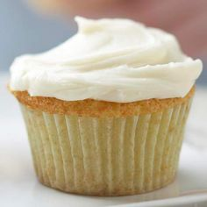
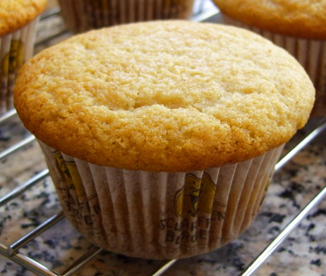
Let’s Compare!
AP COURSES
HONORS COURSES
REGULAR COURSES

Slide 46

Honors Courses
Offer the same curriculum as regular courses but are tailored for high-achieving students
Cover additional topics or some topics in greater depth
Are more intense and faster paced than typical college preparatory courses

Slide 47

Advanced Placement (AP) Courses
Are college-level courses which will help you build college skills
Are fast pace and challenging
Are offered in many subjects such as English, mathematics, history and world languages
Will allow you to receive college credit by taking and passing the AP exam

Slide 48

Let’s review…
Explain the difference between regular, honors and AP courses.
How can you earn college credits while attending high school?

Slide 49





Interesting Facts
The top five ranked historically black colleges and universities are, in order, Spelman College, Howard University, Hampton University, Morehouse College and Tuskegee University.
SOURCE: “HISTORICALLY BLACK COLLEGES AND UNIVERSITIES RANKING” - US NEWS AND WORLD REPORT

Slide 50



Benefits
Honors • Advanced Placement (AP)
COLLEGE READINESS
You will become accustomed to a challenging, fast pace that is similar to that of college courses.
You will be challenged!
COLLEGE ADMISSION
Taking honors and AP courses will let colleges know that you are serious about academics and that you will continue to challenge yourself in college.
COLLEGE CREDIT
If you take and earn high scores on the AP exams, you will start college with college credits.
You may also be exempt from taking certain required college courses.
In addition…
You will be more likely to get scholarships for college.
By earning college credits you will save money and graduate early!

Slide 51

Let’s review…
Name three benefits of taking honors and AP courses.
How can taking AP courses save you and your family a lot of money?
T • P • S

Slide 52

Interesting Facts
32% of American students who study abroad, are hosted by the United Kingdom, Italy and Spain.
The majority of international students in California come from China.
SOURCE: US STUDY ABROAD LEADING DESTINATIONS - INSTITUTE OF INTERNATIONAL EDUCATION

Slide 53
The Noncognitives

Slide 54









The Noncognitive Skills
The Noncognitive Skills are eight skills related to motivation, integrity, and interpersonal interaction. They also involve intellect and are associated with an individual’s personality, temperament and attitudes.
Universities use the Noncognitive Skills in conjunction with grades and test scores to obtain a more complete picture of a student’s abilities.
SOURCE: AMERICAN COLLEGE TEST (ACT) WEBSITE

Slide 55
The Noncognitive Skills
Positive Self-Concept
Realistic Self-Appraisal
Long Range Goals
Able to Navigate Systems

Slide 56
The Noncognitive Skills
Strong Support Person/ Network
Leadership
Community Involvement
Non-Traditional Knowledge

Slide 57
The Noncognitive Skills | How will you incorporate/use these skills daily?
Positive Self-Concept
Long Range Goals
Ability to Navigate Systems
Realistic Self-Appraisal
Strong Support Person/Network
Leadership
Community Involvement
Non-Traditional Knowledge
Let’s review…

Slide 58
Let’s Create a Daily Schedule
M
T
W
TH
F
S
S
v
v
v
v
v
6:30 AM
Wake-Up
7:30 -3:30
School
3:30 -5:00
Sports • Music • Volunteer
5:00 -6:00
Dinner and Chores
6:00 –7:30
Homework
• Study
7:30 – 9:00
Hobby • other
9:00
Bedtime
Notes:
Importance of a routine – talk about an agenda to know when things are due

Slide 59
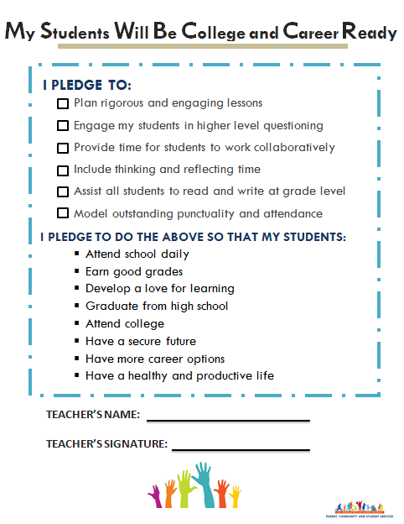



Your teacher will take the pledge!

Slide 60
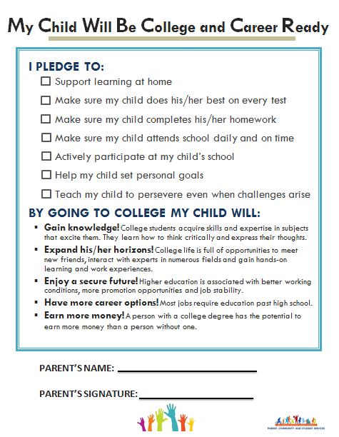

Encourage your family to take the pledge!

Slide 61
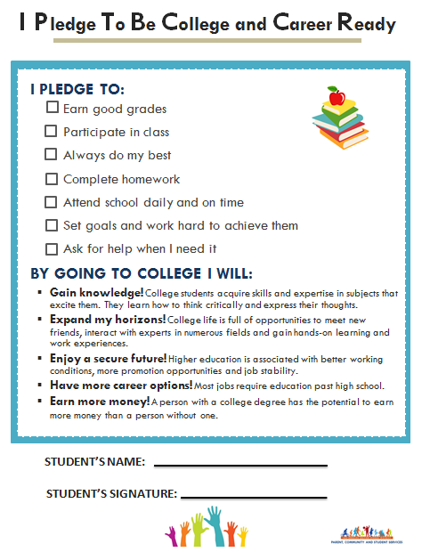
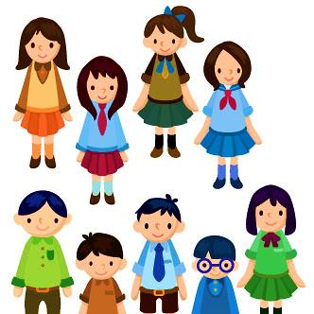
Now you take the pledge!

Slide 62
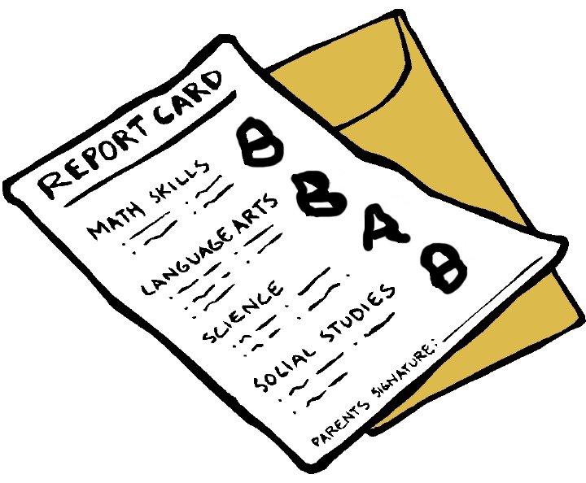
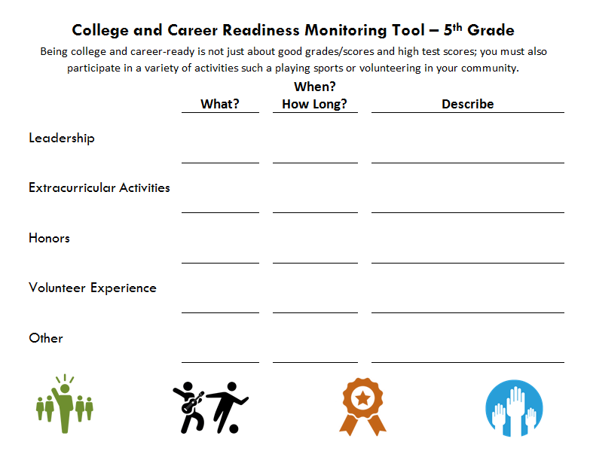




College Box
What can be in your college box?
When do you think you should you start one?

Slide 63
College and Career Readiness
How do we become college and career ready?

Slide 64
OBJECTIVES
  Understand the benefits of being college and career ready
  Increase your knowledge of the A-G subject requirements
  Learn about the requirements for the Middle School Certificate of Completion and Culmination Activity
  Use the College and Career Readiness Monitoring Tool to track your academic progress
  Increase your awareness of honors and advanced placement (AP) courses
  Understand the importance of a competitive grade point average (GPA)
  Gain knowledge about the Noncognitive Skills
√
√
√
√
√
√
√

Slide 65

Questions?

Slide 66
The Student Involvement, Development, and Empowerment Unit wishes you success as you prepare to be college and career ready.

Slide 67

PARENT, COMMUNITY AND STUDENT SERVICES

